Slide 1
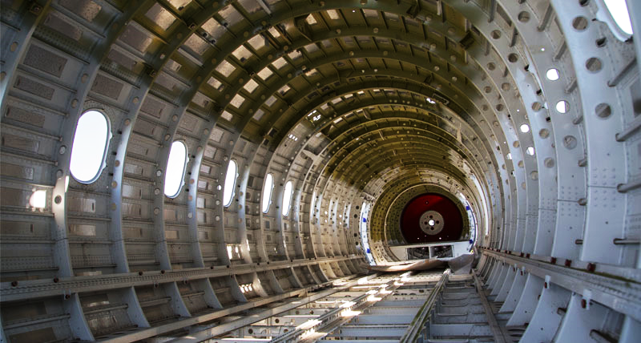


Diploma’s Thesis Presentation
Investigation and numerical modelling of buckling and post-buckling behaviour of stiffened aircraft fuselage panels
Nikolaos Rigatos
Supervisor: Georgios Lampeas, Professor
Πάτρα, 13/07/2022

Slide 2

Contents
Introduction
Purpose of study
Development of numerical models
Validation of numerical models
Numerical models of stiffened fuselage panels
Conclusions
Future work
References
2

Slide 3
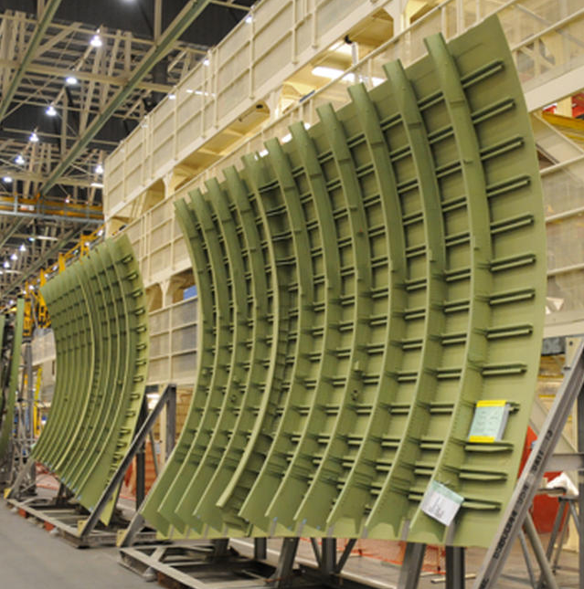
Introduction (1/2) – Stiffened panels
Skin
The fuselage is subjected to:
Axial tensile loads
Axial compressive loads
Combination of tensile/compressive loads
Stringers
Frames
They are primarily constructed from:
Aluminum alloys
Multilayer carbon fiber–reinforced polymer (CFRP) composites
Stiffened Panel - Boeing 747-800 [1]
3
3

Slide 4
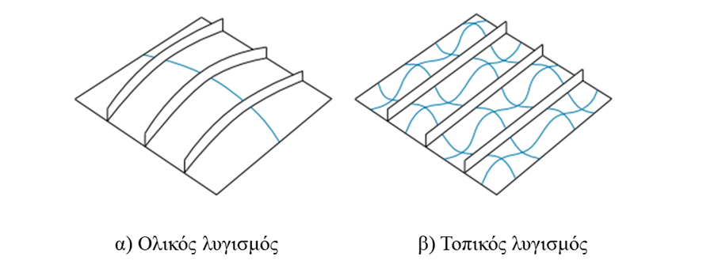
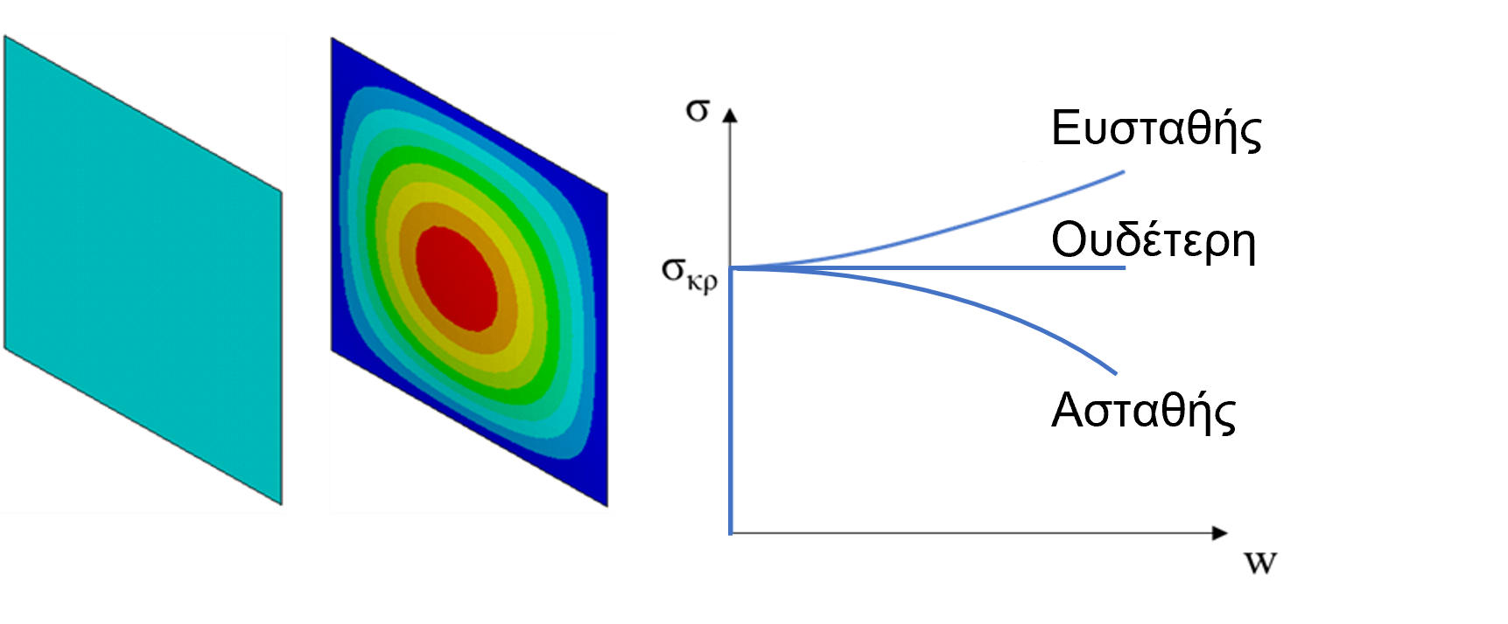
Introduction (2/2) - Buckling
Buckling ● The loss of a structure’s ability to retain its configuration when subjected to external loads, leading to abrupt deformations and significant displacements.
Stable
Neutral
Unstable
[2]
α) Global buckling
β) Local buckling
4
Πάτρα, 13/07/2022
4

Slide 5
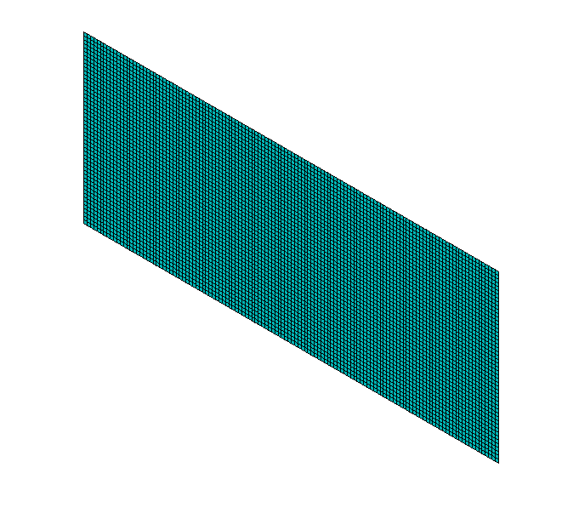
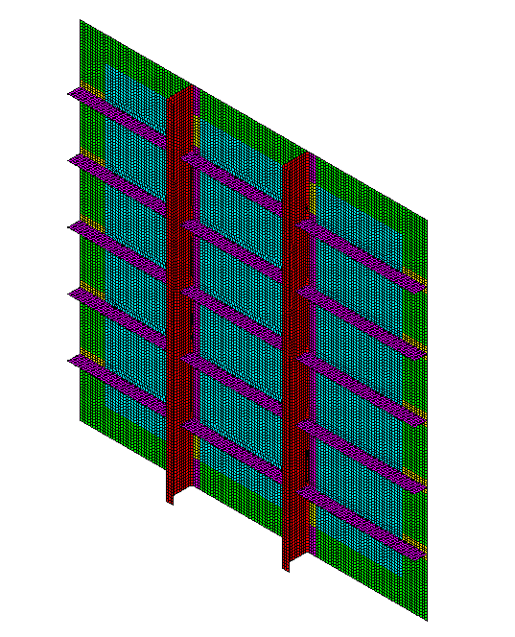
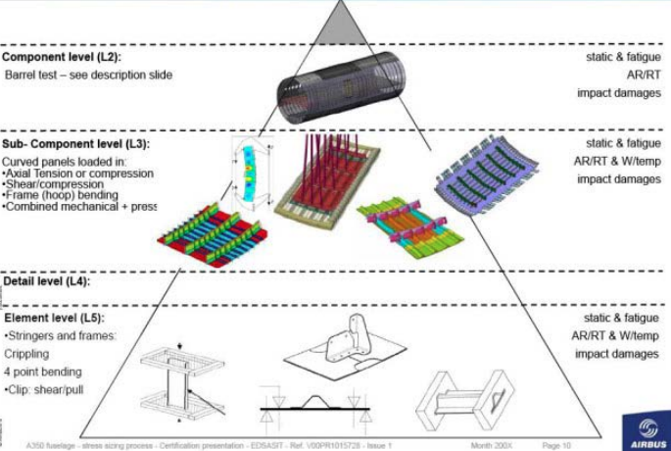
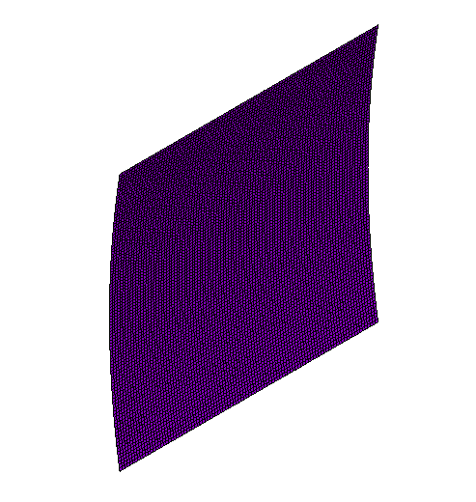
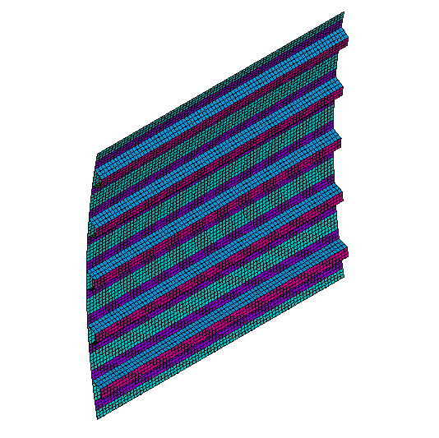
Purpose of study
Validation of fuselage design
1. Analytical equations
2. Experimental methods
3. FEM
Main goals
Investigation of numerical methods for predicting the buckling of stiffened shells
Parametrization of the problem
Validation of numerical models
Study of combined compression/shear buckling in stiffened fuselage panels
Load cases:
Axial compression
In-plane shear
Combined compression/shear
5
Πάτρα, 13/07/2022
5

Slide 6
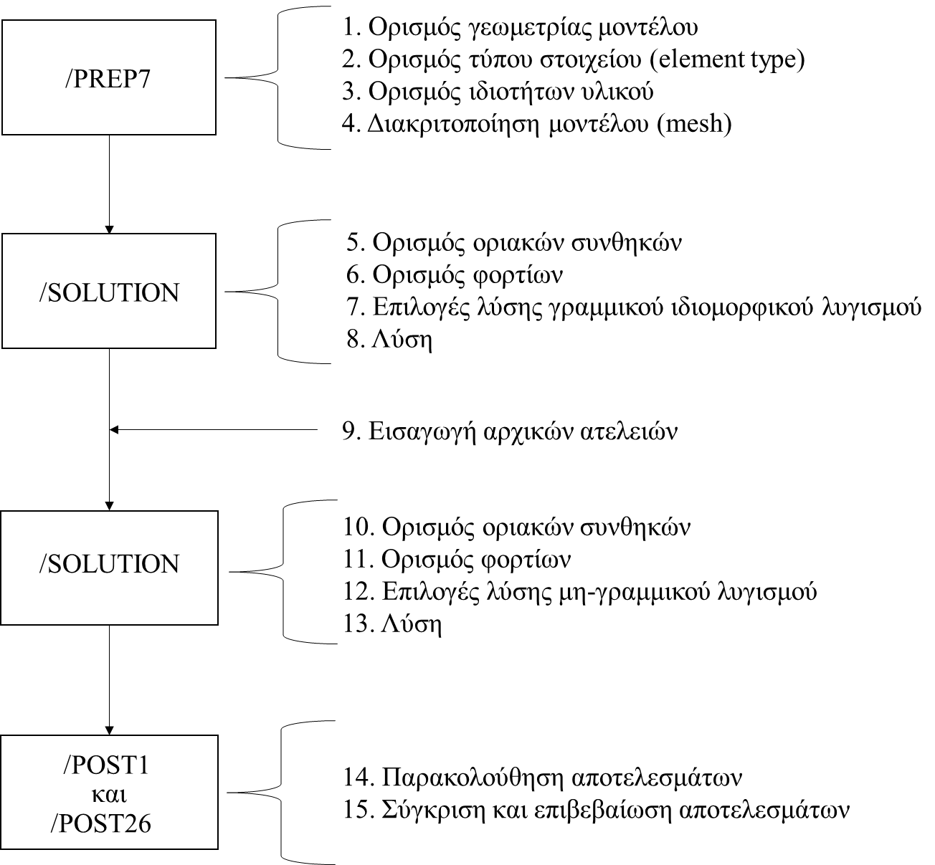
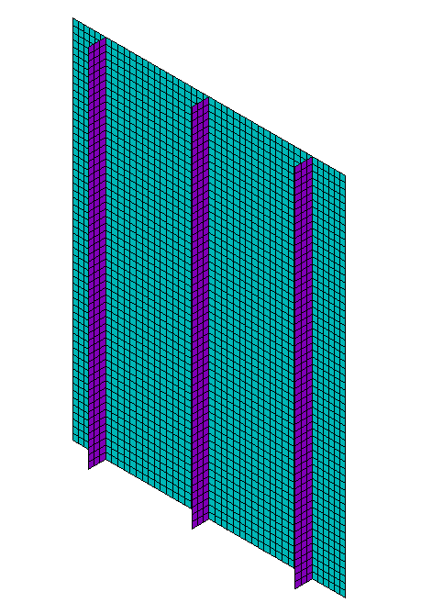
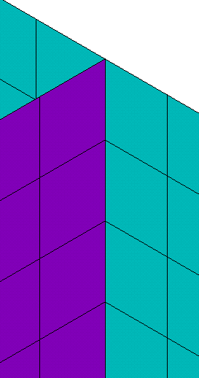
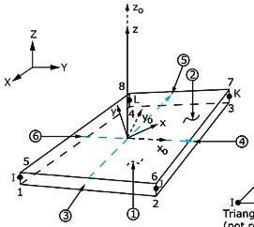
Development of numerical models
1. Geometry definition
2. Element type definition
3. Material characterization
4. Meshing
Method of Shared Nodes
5. Boundary conditions
6. Loads
7. Buckling linear analysis solvers
8. Solution
9. Introduction of initial imperfections
10. Boundary conditions
11. Loads
12. Buckling non-linear analysis solvers
13. Solution
SHELL181
14. Investigation of results
15. Comparison and validation of results
6
6

Slide 7
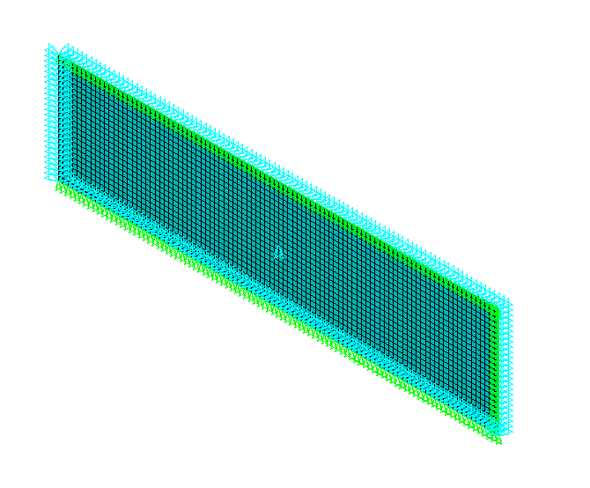
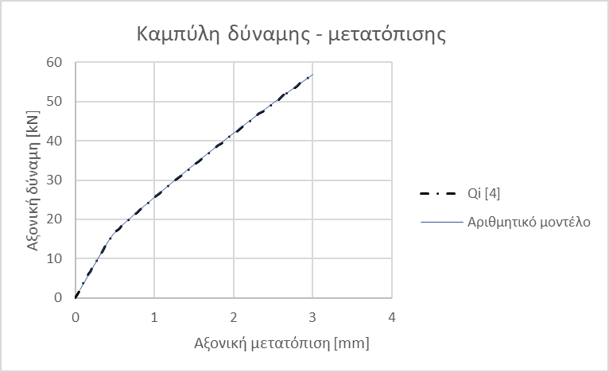
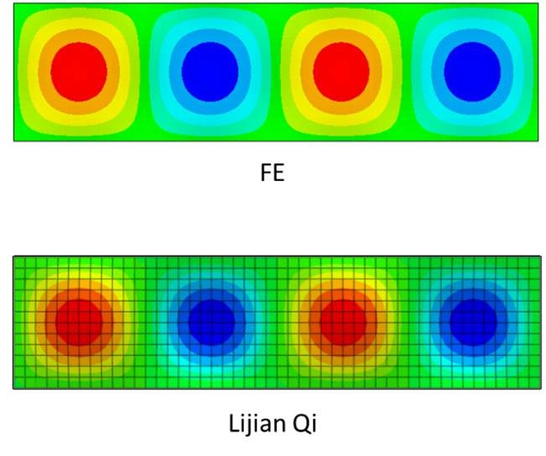

Validation of numerical models (1/9)
1. Axial compression load case
i. Plate
Timoshenko Analytical Equation [3]
N_{cr,FE} | N_{cr,an} | ε
kN | kN | %
17.08 | 17.05 | 0.15
$$σ_{cr}=κ\frac{π^{2}Ε}{12\left(1−ν^{2}\right)}{\left(\frac{t}{b}\right)}^{2}$$
Qi [4]
Αριθμητικό μοντέλο
2
7

Slide 8
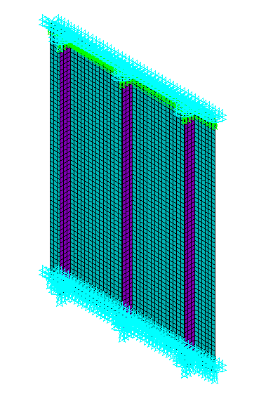
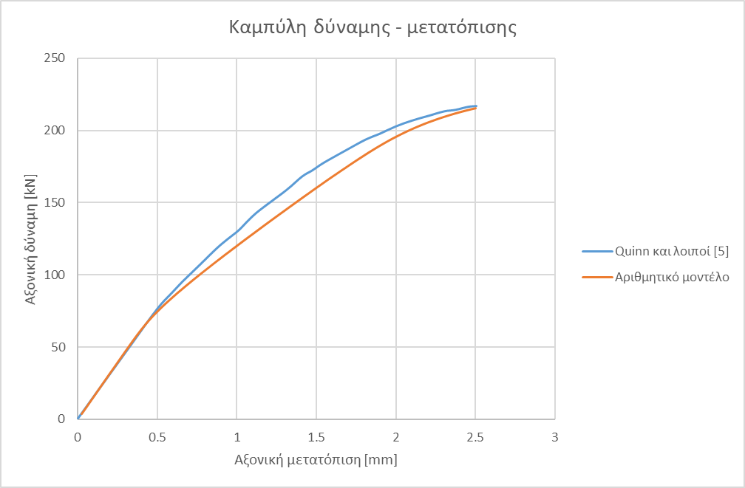
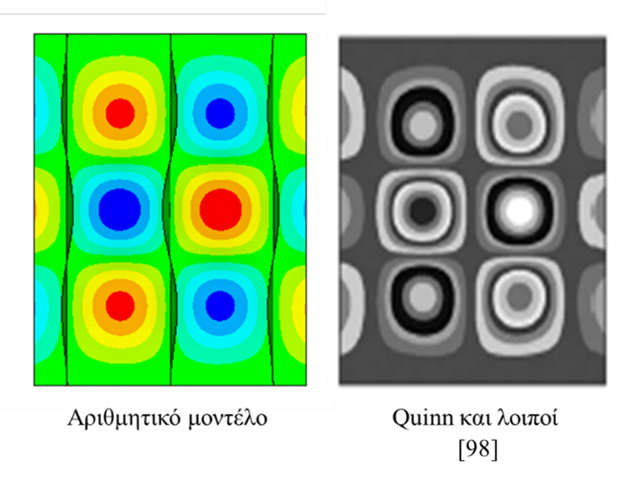
Validation of numerical models (2/9)
1. Axial compression load case
ii. Stiffened plate
Numerical model
Quinn et al[5]
2
8

Slide 9
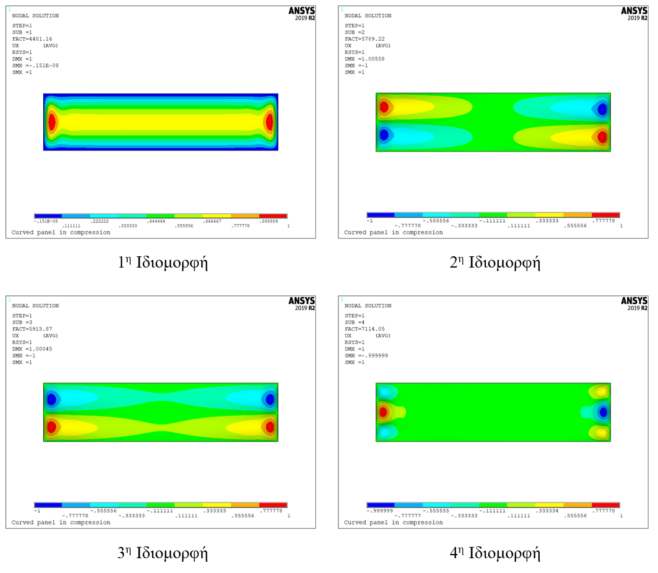
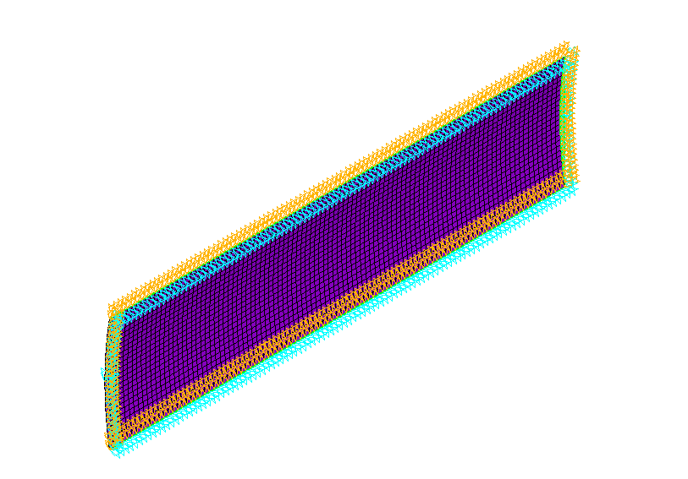
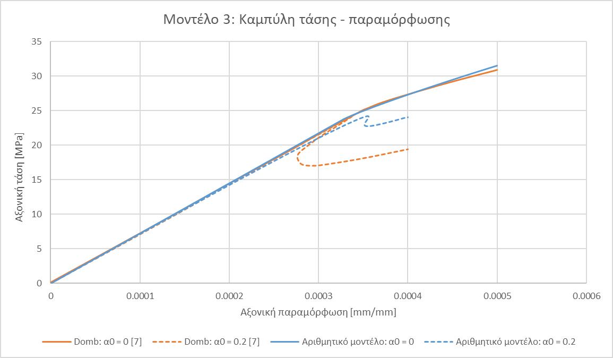
Validation of numerical models (3/9)
1. Axial compression load case
iii. Shell
1. Περίπτωση φόρτισης αξονικής θλίψης
1st eigenmode
2nd eigenmode
The eigenmodes agree with Tran’s observations [6]
3rd eigenmode
4th eigenmode
2
9

Slide 10
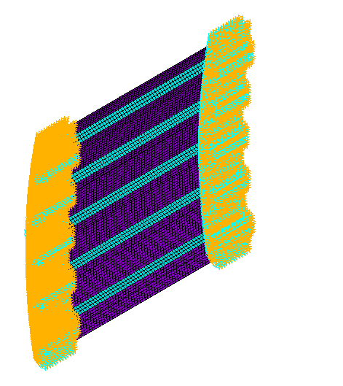
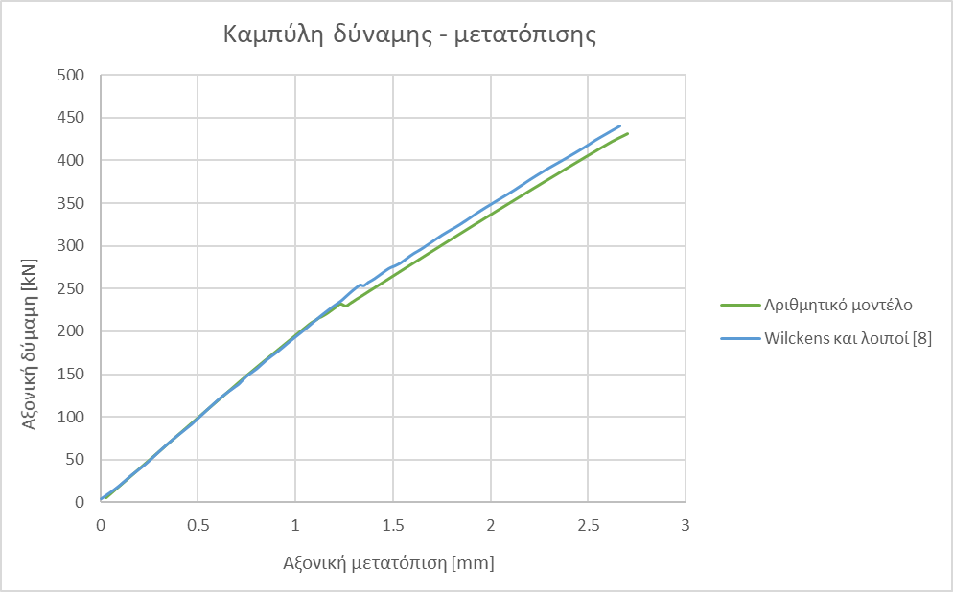
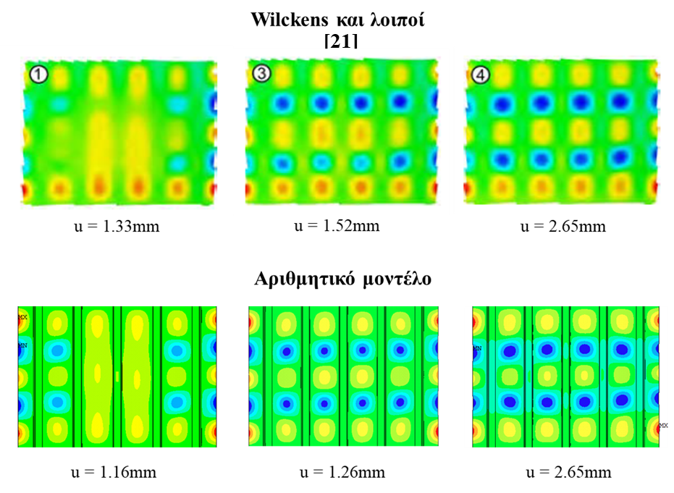
Validation of numerical models (4/9)
1. Axial compression load case
iv. Stiffened panel
1. Περίπτωση φόρτισης αξονικής θλίψης
Wilckens et al[8]
Numerical model
2
10

Slide 11
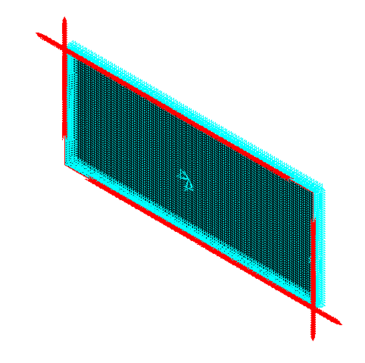
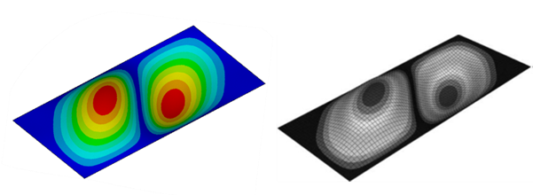
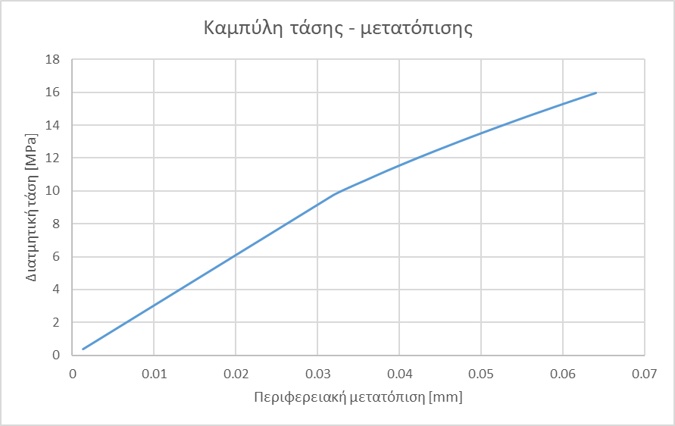

Validation of numerical models (5/9)
2. In-plane shear load case
i. Flat plate
Timoshenko analytical equation [3]
σ_{cr,FE} | σ_{cr,an} | ε
MPa | MPa | %
9.83 | 9.74 | 0.86
$$σ_{cr}=κ_{s}\frac{π^{2}D}{b^{2}t}$$
Numerical model
Amani et al [9]
2
11

Slide 12
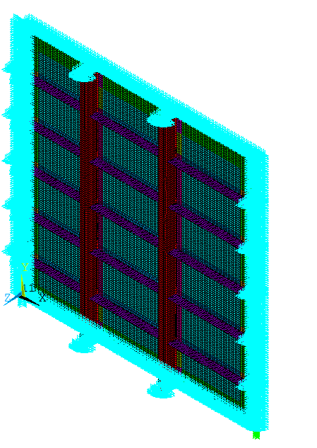
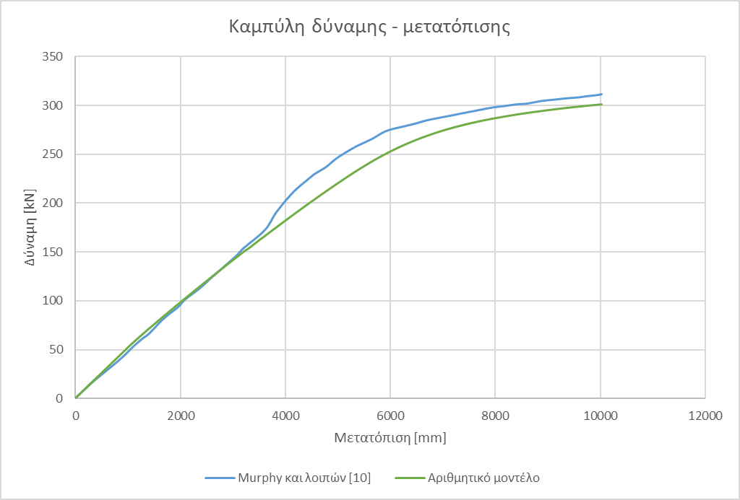
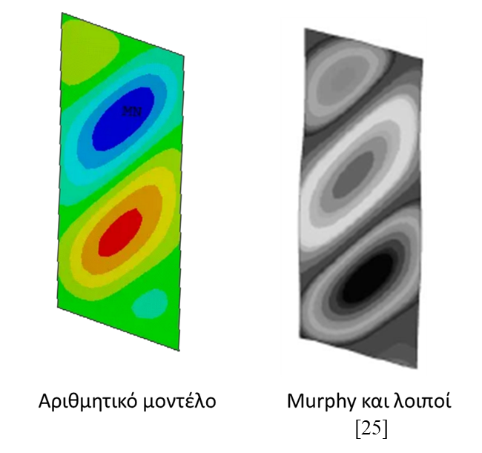
Validation of numerical models (6/9)
2. In-plane shear load case
ii. Stiffened plate
Αριθμητικό μοντέλο
Murphy et al [10]
2
12

Slide 13
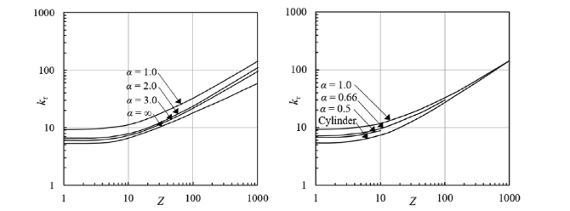
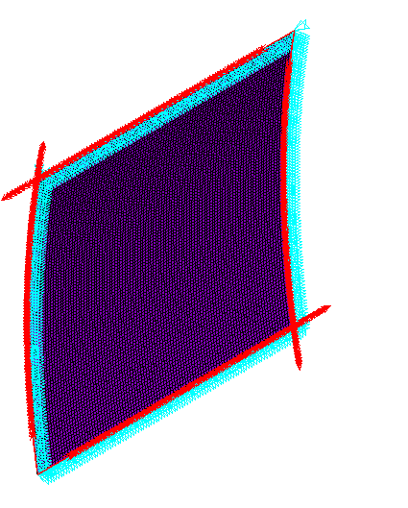
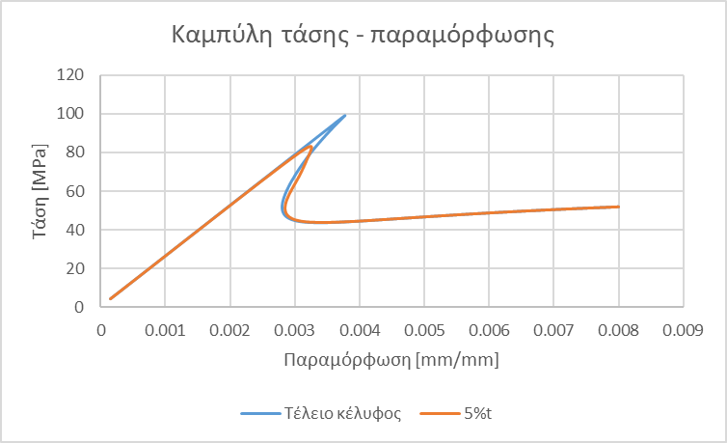
Επιβεβαίωση αριθμητικών μοντέλων (7/9)
2. In-plane shear load case
iii. Shell
σ_{cr,FE} | σ_{cr,an} | ε
MPa | MPa | %
100.1 | 103.3 | 3.16
NACA design curves [11]
σ_{cr,FE} | σ_{cr,Domb} [11] | ε
MPa | MPa | %
83.3 | 84.4 | 1.3
2
13

Slide 14
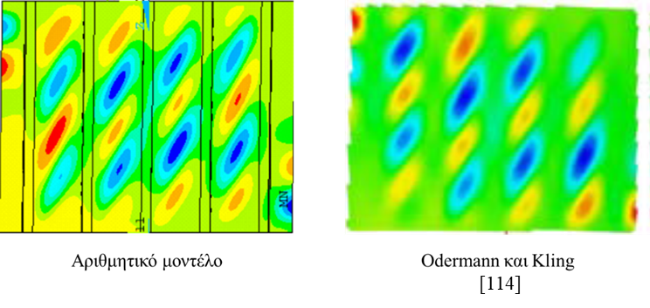
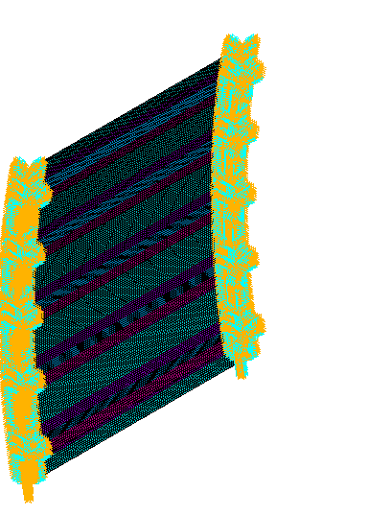
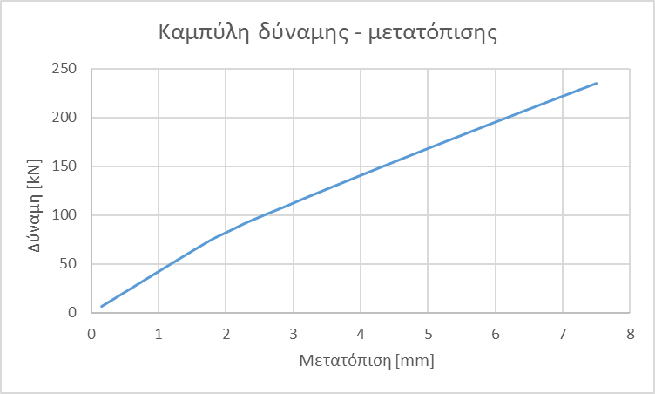
Validation of numerical models (8/9)
2. In-plane shear load case
iv. Stiffened panel
Odermann and Kling [12]
Numerical model
2
14

Slide 15
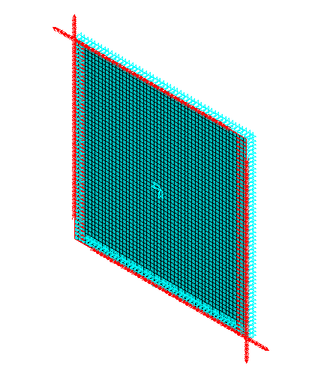
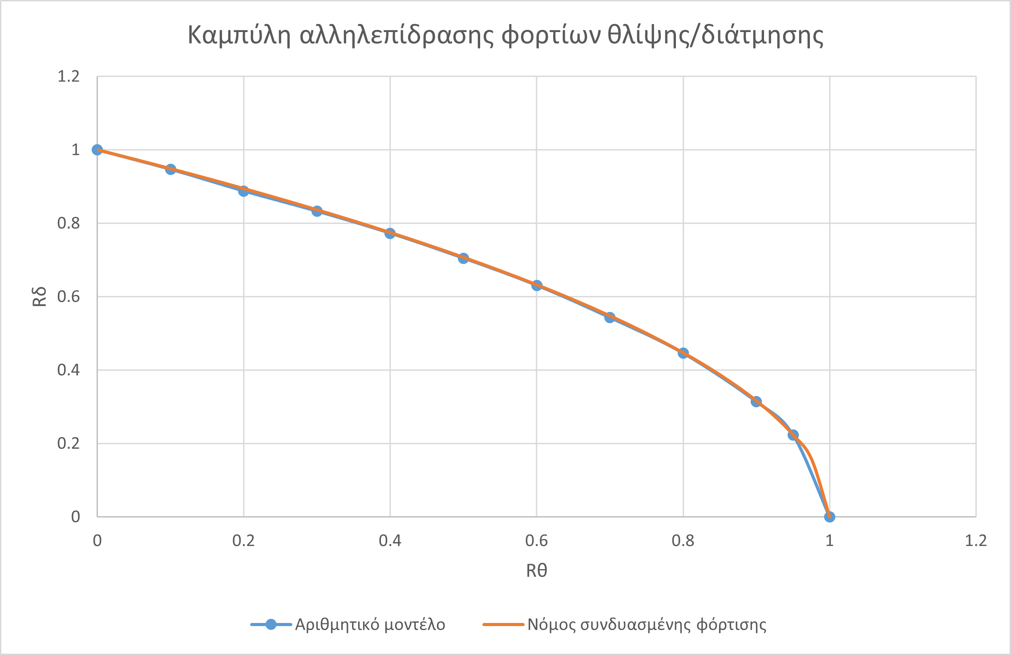
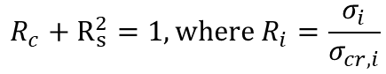
Validation of numerical models (9/9)
3. Combined compression/shear load case
i. Flat plate
3. Περίπτωση σύνθετης φόρτισης θλίψης/διάτμησης
Buckling compression and shear interaction curve:
$$R_{c}+R_{s}^{2}=1, where R_{i}=\frac{σ_{i}}{σ_{cr,i}}$$
16
15

Slide 16
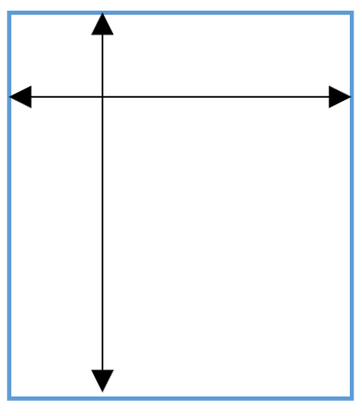
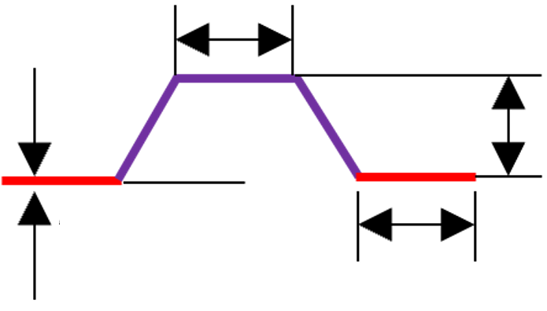
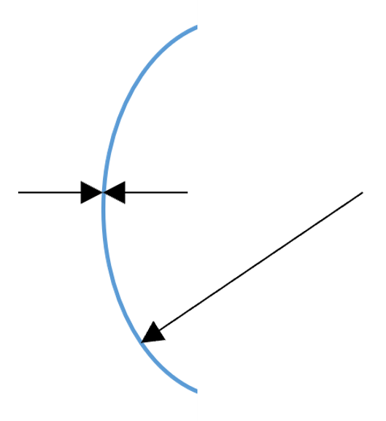
Numerical models of stiffened fuselage panels (1/3)
Geometry
Material properties
Shell
Stringers
Isotropic
Orthotropic
Aluminum Alloy
Ε 70GPa
ν 0.33
CFRP
Ε₁₁ 131GPa
E₂₂ 11.2GPa
ν₁₂ 0.33
G₁₂ 5.3GPa
G₁₃ 5.3GPa
G₂₃ 3.95GPa
800mm
25mm
25mm
60°
1.2mm
25mm
750mm
5 stringers
Distance of 150mm between them
Length of 600mm
1.6mm
Ply sequencing of orthotropic material
Shell
Stringers
2000mm
[45,-45,0,90,-45,45,0]_{s}
[45,0,-45,0,90]_{s}
2
16

Slide 17
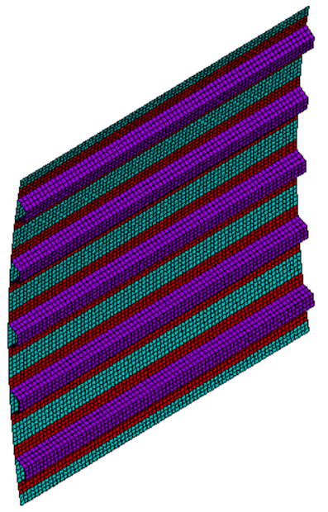
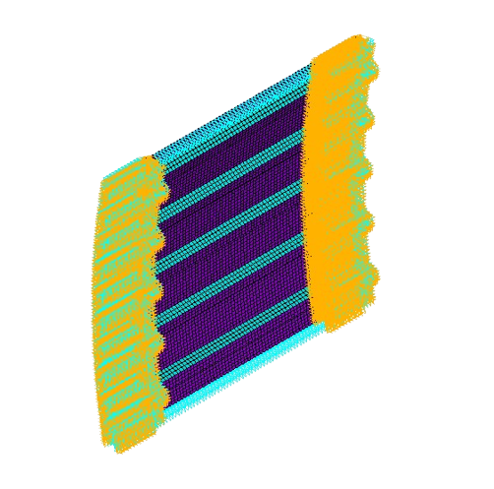
Numerical models of stiffened fuselage panels (2/3)
Mesh convergence check
Numerical model and boundary conditions
Aluminum
CFRP
Element size | N_{cr} | ε
mm² | kN | %
50x50 | 338.6 | -
25x25 | 238.7 | 41.8
12.5x12.5 | 220.7 | 8.17
10x10 | 218.7 | 0.90
5x5 | 217.5 | 0.56
Element size | N_{cr} | ε
mm² | kN | %
50x50 | 408.9 | -
25x25 | 296.7 | 37.8
12.5x12.5 | 270.8 | 9.55
10x10 | 268.7 | 0.78
5x5 | 266.1 | 0.98
Element size selected is 10x10mm²
2
17

Slide 18
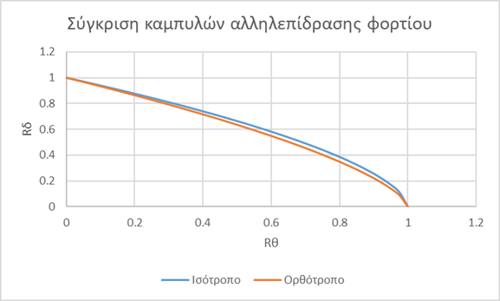
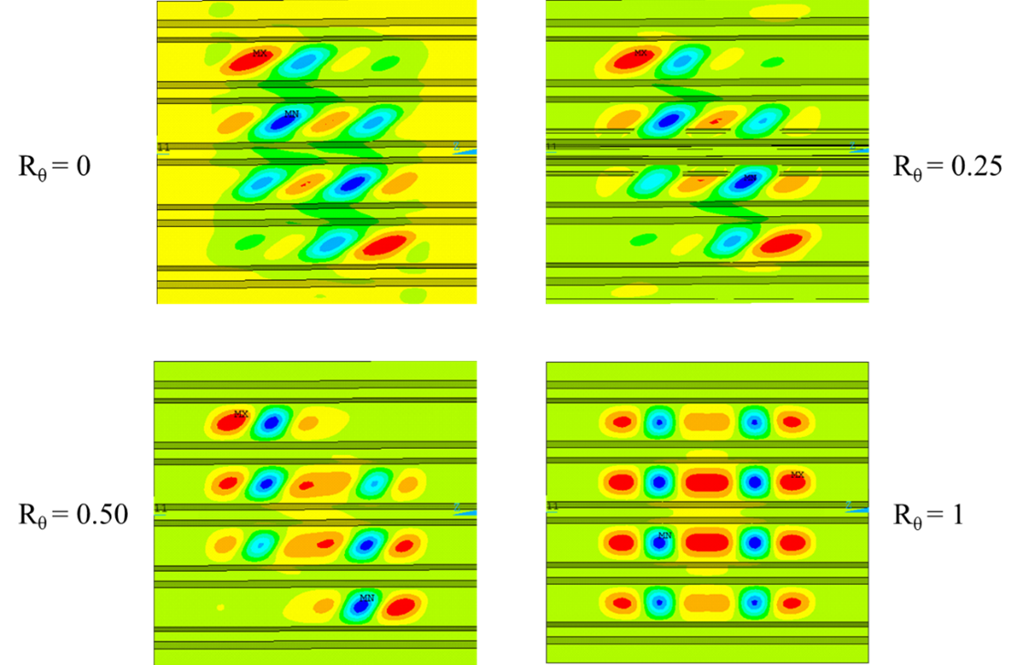
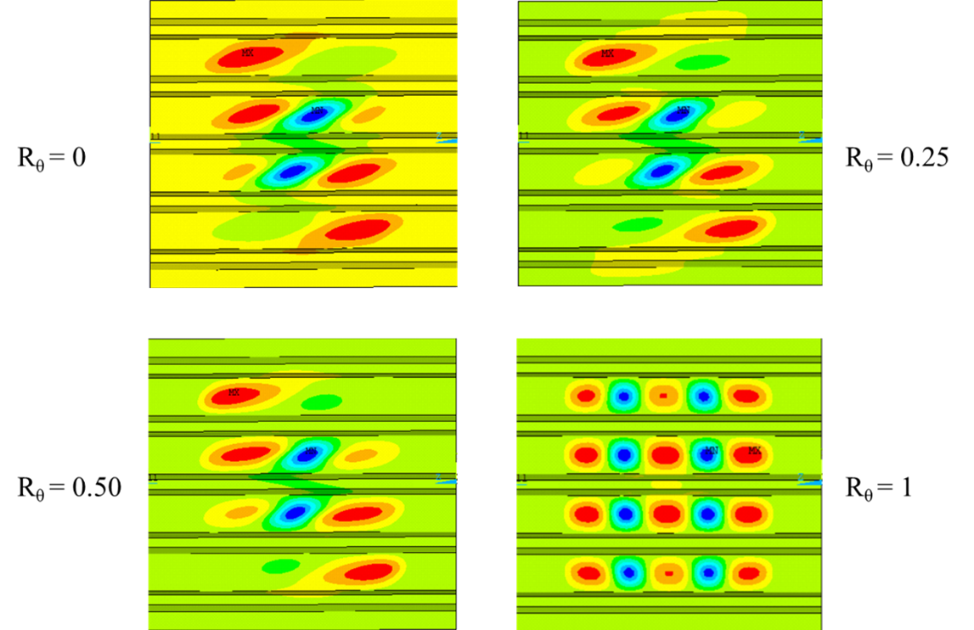
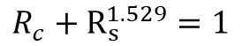
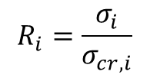


Numerical models of stiffened fuselage panels (3/3)
Results
 | σ_{cr,c} [kN] | σ_{cr,s} [kN]
Aluminum | 416.3 | 229.1
CFRP | 322.7 | 142.4
ε (%) | 29 | 60
For the aluminum fuselage panel it is calculated:
$$R_{c}+R_{s}^{n}=1$$
$$R_{c}+R_{s}^{1.694}=1$$
$$R_{i}=\frac{σ_{i}}{σ_{cr,i}}$$
For the CFRP fuselage panel it is calculated:
$$R_{c}+R_{s}^{1.529}=1$$
2
18

Slide 19

Conclusions
Αριθμητικά μοντέλα
Σύνθετη φόρτιση ενισχυμένων κελυφών
The critical buckling load, the pre-buckling stiffness, the resulting mode shapes, and the failure mechanism are predicted with high accuracy.
The post-buckling behavior of the structures is computed with satisfactory accuracy.
The numerical models are fully parametric.
In stiffened shells, the load interaction curve has the form: $R_{c}+R_{s}^{n}=1$
Since n_{orthotropic} < n_{isotropic}, orthotropic stiffened shells are more sensitive to shear loads than their isotropic counterparts, highlighting the need for careful design of fuselage panels made from orthotropic materials compared to conventional aluminum panels.
Deviations in the post-buckling regime are due to:
Initial imperfections.
Plasticity models.
The modeling approach of the interface between the skin and stiffeners.
20
19

Slide 20
Future work
Further development of numerical models
Validation of fuselage panel results
Validation for additional loading cases.
Incorporation of nonlinear phenomena for more accurate prediction in the post-buckling regime.
Parametric study of the effect of geometry, material properties, and ply orientation on the interaction curve.
Experimental investigation for the validation and enhancement of numerical model accuracy.
2
20

Slide 21
References
[1] Terdiman Daniel, CNET, https://www.cnet.com/pictures/where-boeings-next-gen-747-8-comes-to-life-photos/34/
[2] N. Liu, “Global and local buckling analysis of stiffened and sandwich panel using mechanics of structure genome”, West Lafayette, Indiana, 2019
[3] S.P. Timoshenko, J.M. Gere, “Theory of elastic stability”, New York: McGraw-Hill, 1963
[4] L. Qi, “A study of the buckling behaviour of stiffened panels under compression and lateral Pressure”, 2018
[5] D. Quinn, A. Murphy, W. McEwan και F. Lemaitre, “Stiffened panel stability behaviour and performance gains with plat prismatic sub-stiffening”, Thin-Walled Structures, vol. 47, no.12, 1457-1468, 2009
[6] K. Tran και L. Davaine, “Stability of cylindrical steel panels under uniform axial compression”, Annual Stability Conference, Pittsburgh, 2011
[7] M. Domb και B. Leigh, “Refined design curves for compression buckling of curved panels using nonlinear finite element analysis”, 2011
[8] D. Wilckens, F. Odermann και Α. Kling, “Stringer stiffened panel under axial compression, shear and combined loading conditions – Test and numerical analysis”, European Conference of Composite Materials, Italy, 2012
[9] M. Amani, B. Edlund και M. Alinia, “Buckling and Postbuckling behaviour of unstiffened slender curved plates under uniform shear”, Thin-Walled Structures, vol. 49, 1018-1031, 2011
[10] A. Murphy, M. Price, C. Lynch και A. Gibson, “The computational post-buckling analysis of fuselage stiffened panels loaded in shear”, Thin-Walled Structures, vol. 42, 1455-1474, 2005
[11] M. M. Domb και B. R. Leigh, “Refined design curves for shear buckling of curved panels using nonlinear finite element analysis”, 43rd AIAA/ASME/ASCE/AHS/ASC Structures, Structural Dynamics, and Materials Con, Denver, Colorado, 2002
[12] F. Odermann και A. Kling, «Shear-Compression Buckling Test Method on Curved Stiffened Composite Panels,» σε European Conference on Composite Materials, Seville, Spain, 2014
2
21

Slide 22
Thank you for your attention!
2

